Slide 1
Covid Data Analysis in AWS

Slide 2
OBJECTIVE
To perform data analysis and visualization on Covid-19 data using ETL tools.
To perform data analysis on Covid_19 data and extract the meaningful information from the dataset which will help in taking quick and informed decision.

Slide 3
TECHNOLOGIES USED
AWS Glue
SparkSQL
Redshift
AWS S3
SparkSQL
Crawler
AWS Lambda
PySpark

Slide 4
SCHEMA REPRESENTATION
IndividualDetails
Id
government_id
age
gender
detected_city
detected_district
detected_state
nationality
current_status
status_change_date
notes
Covid_19_India
Sno
Date
Time
State/UnionTerritory
ConfirmedIndianNational
ConfirmedForeignNational
Cured
Deaths
Confirmed

Slide 5
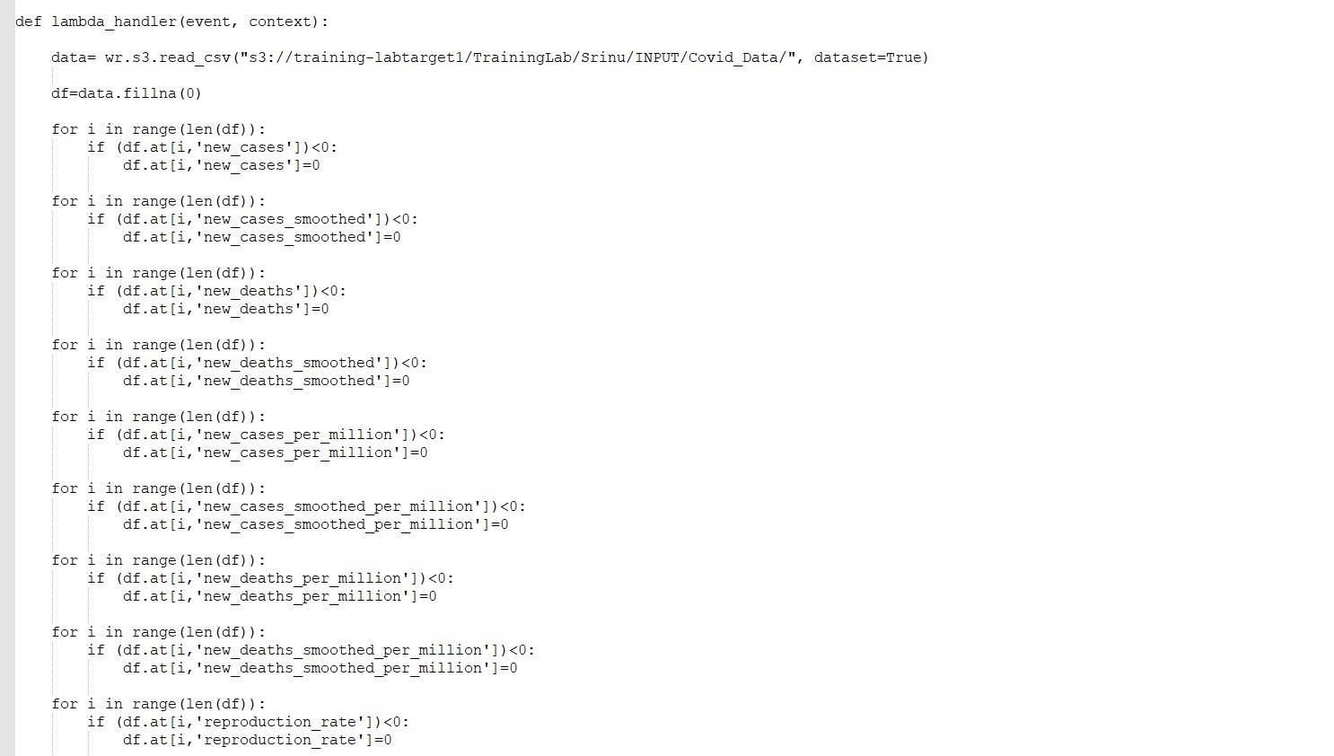
Problem Statements 1.Clean and transform data for processing

Slide 6
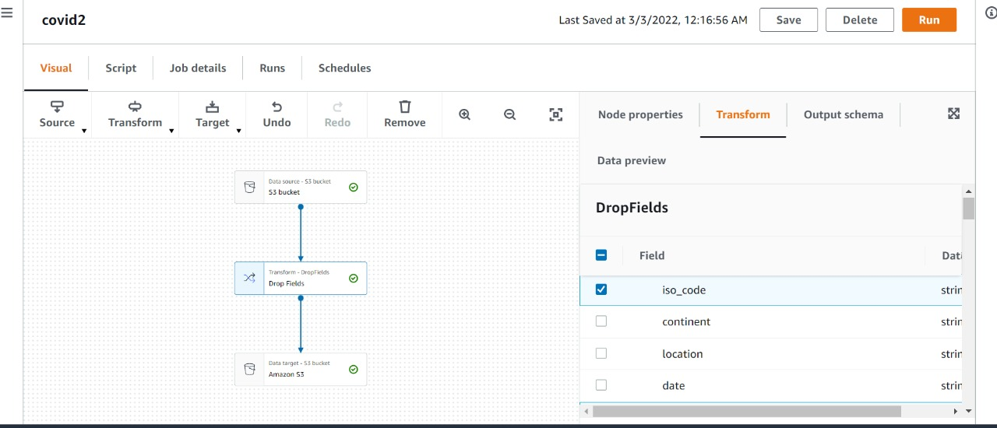
2. ETL operations on dataset Cont…

Slide 7
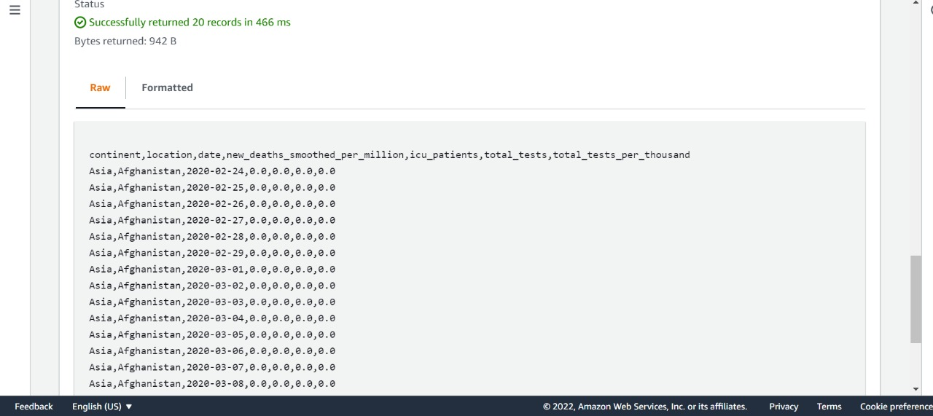

Slide 8
3. Storing the modified data in AWS

Slide 9
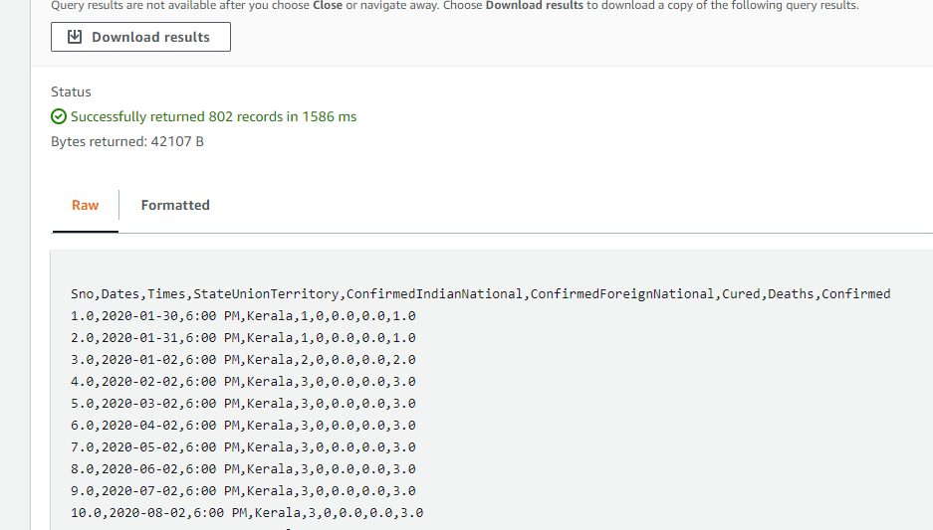

Slide 10
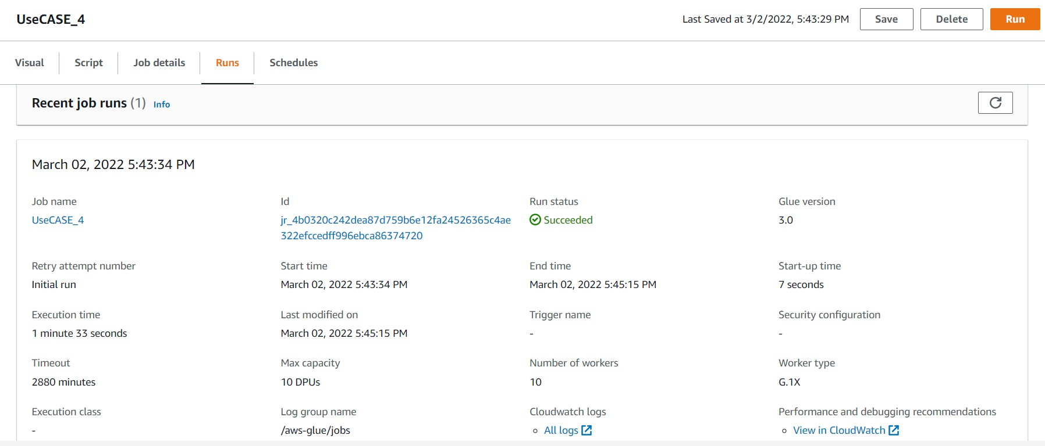
4.Display total cases ,new cases ,recovered cases and deaths

Slide 11
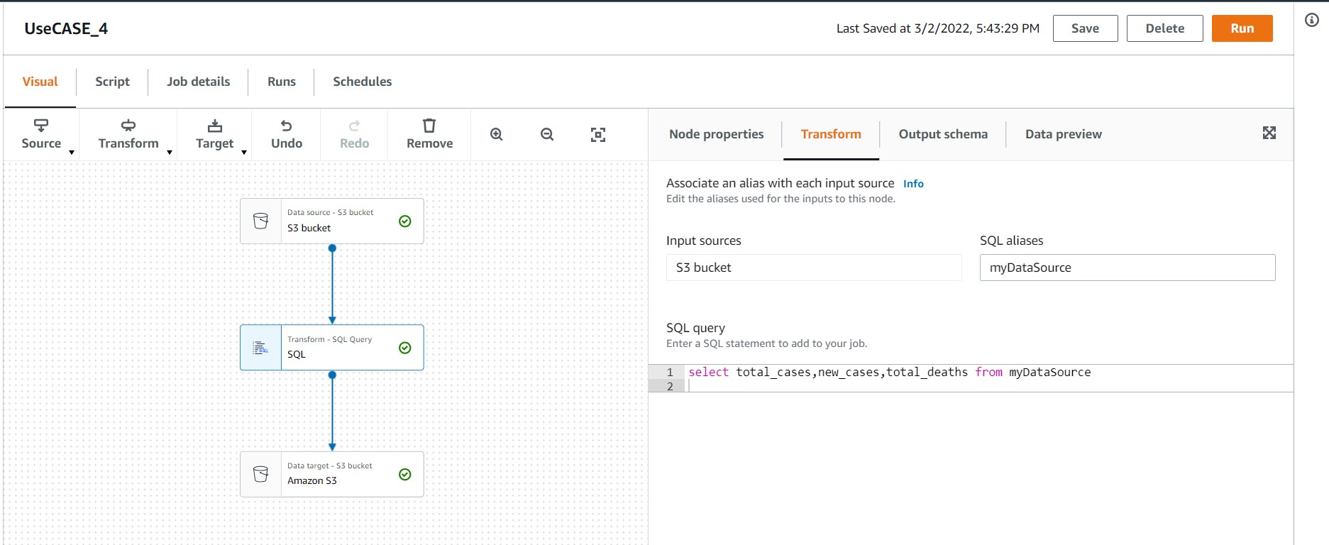

Slide 12
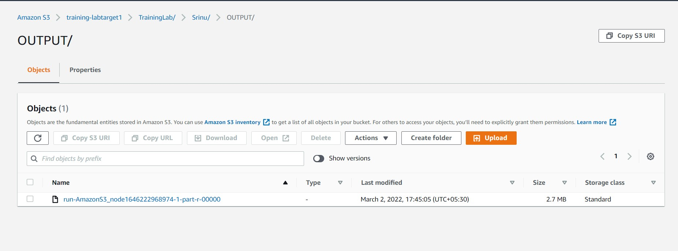

Slide 13
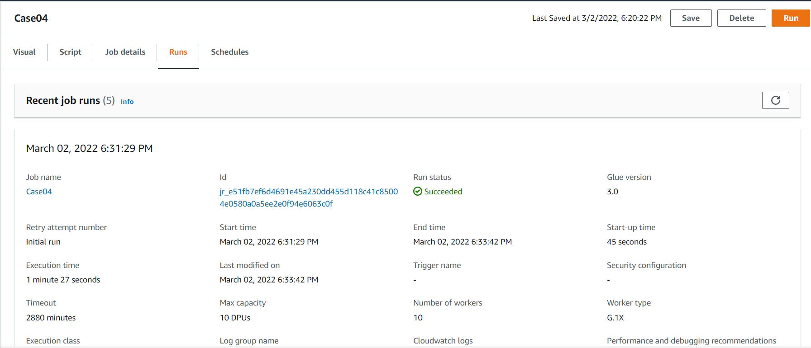
5. Which country in Distinct WHO region highest cases in till date.

Slide 14
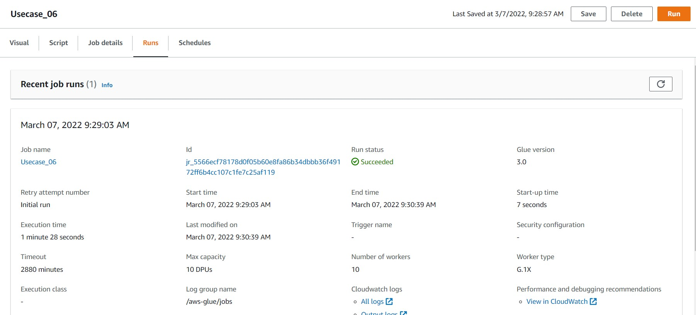
6. Total no of confirmed cases over between a certain date Cont…

Slide 15
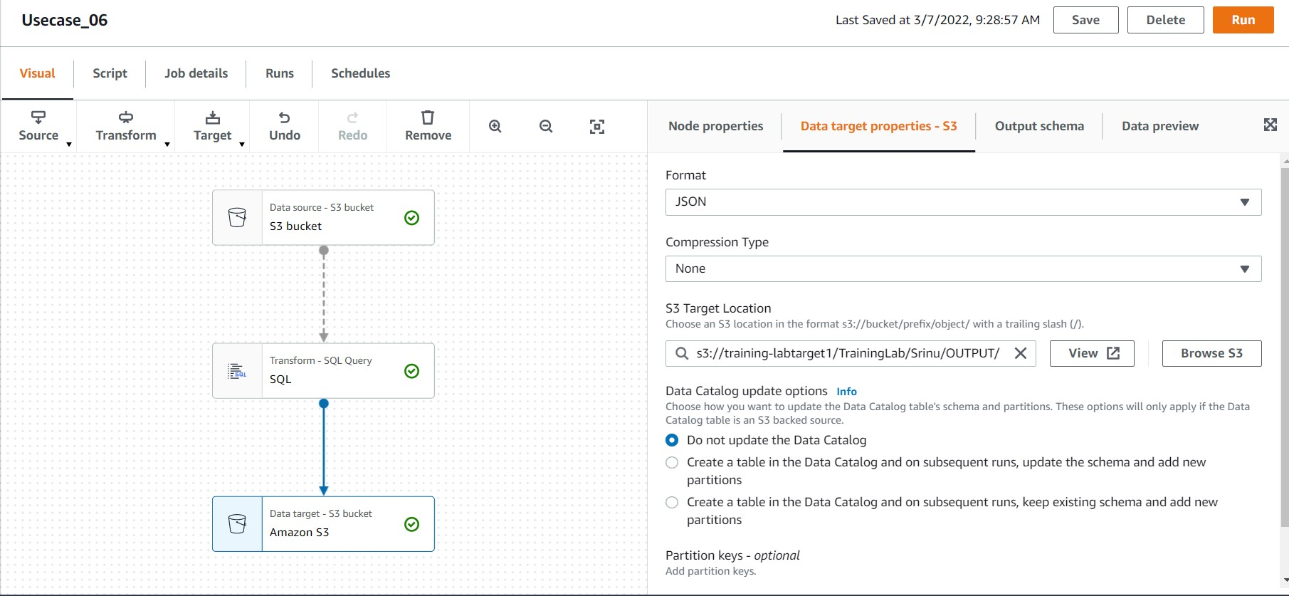

Slide 16
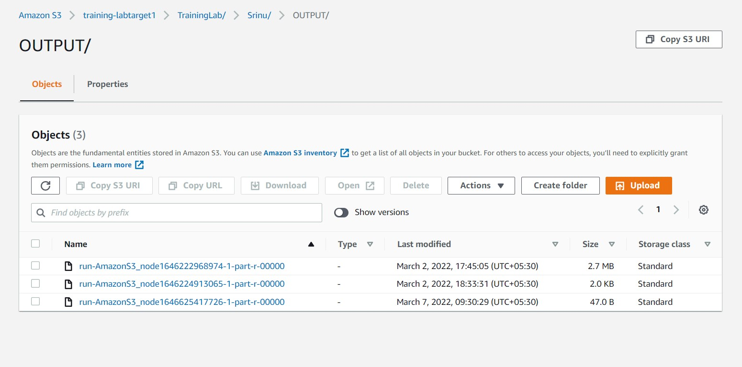

Slide 17
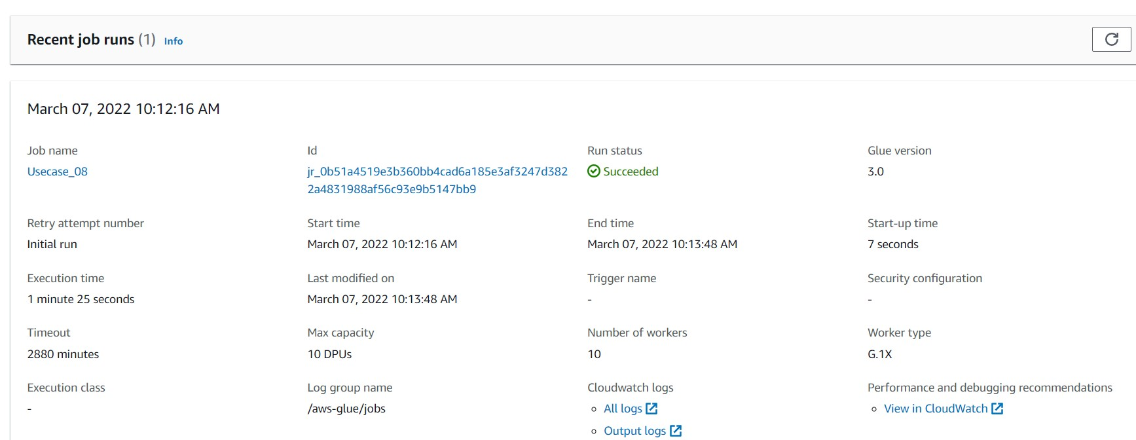
8.Date of first confirmed case in a particular region.

Slide 18
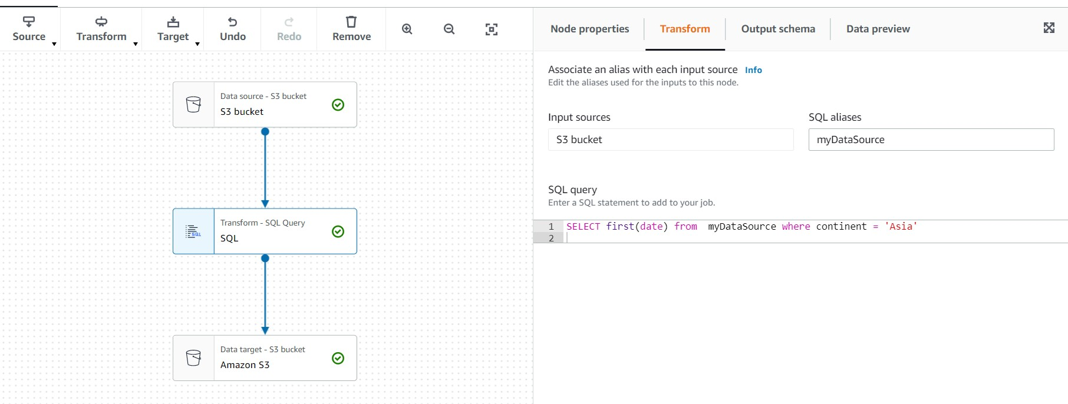

Slide 19
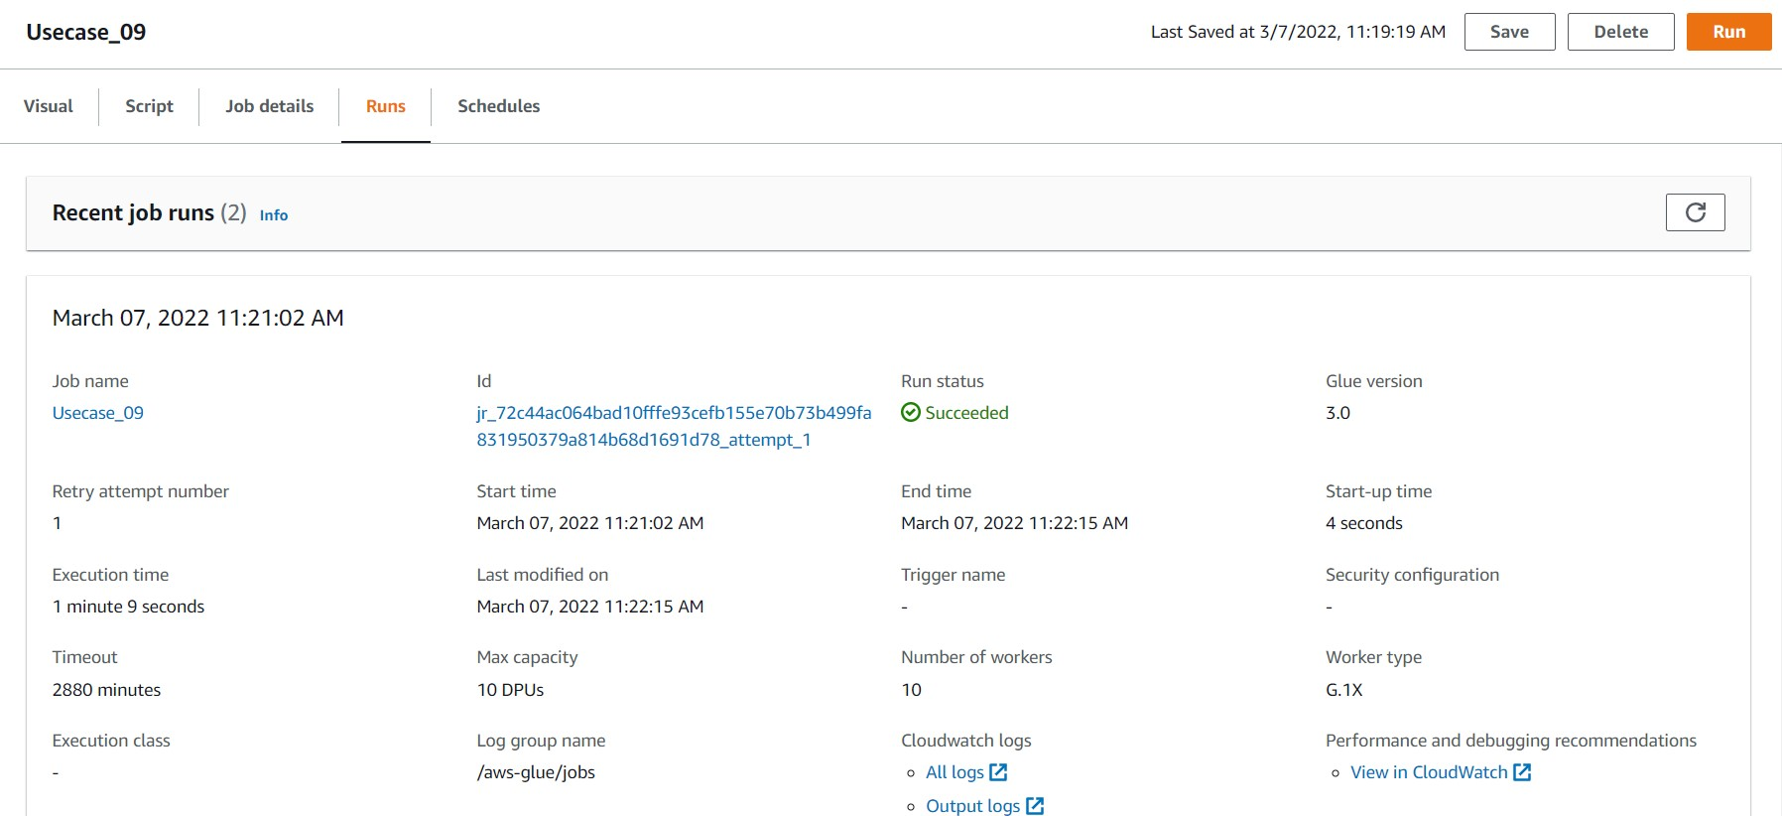
9.Date on which max no. cases were reported in a country.

Slide 20
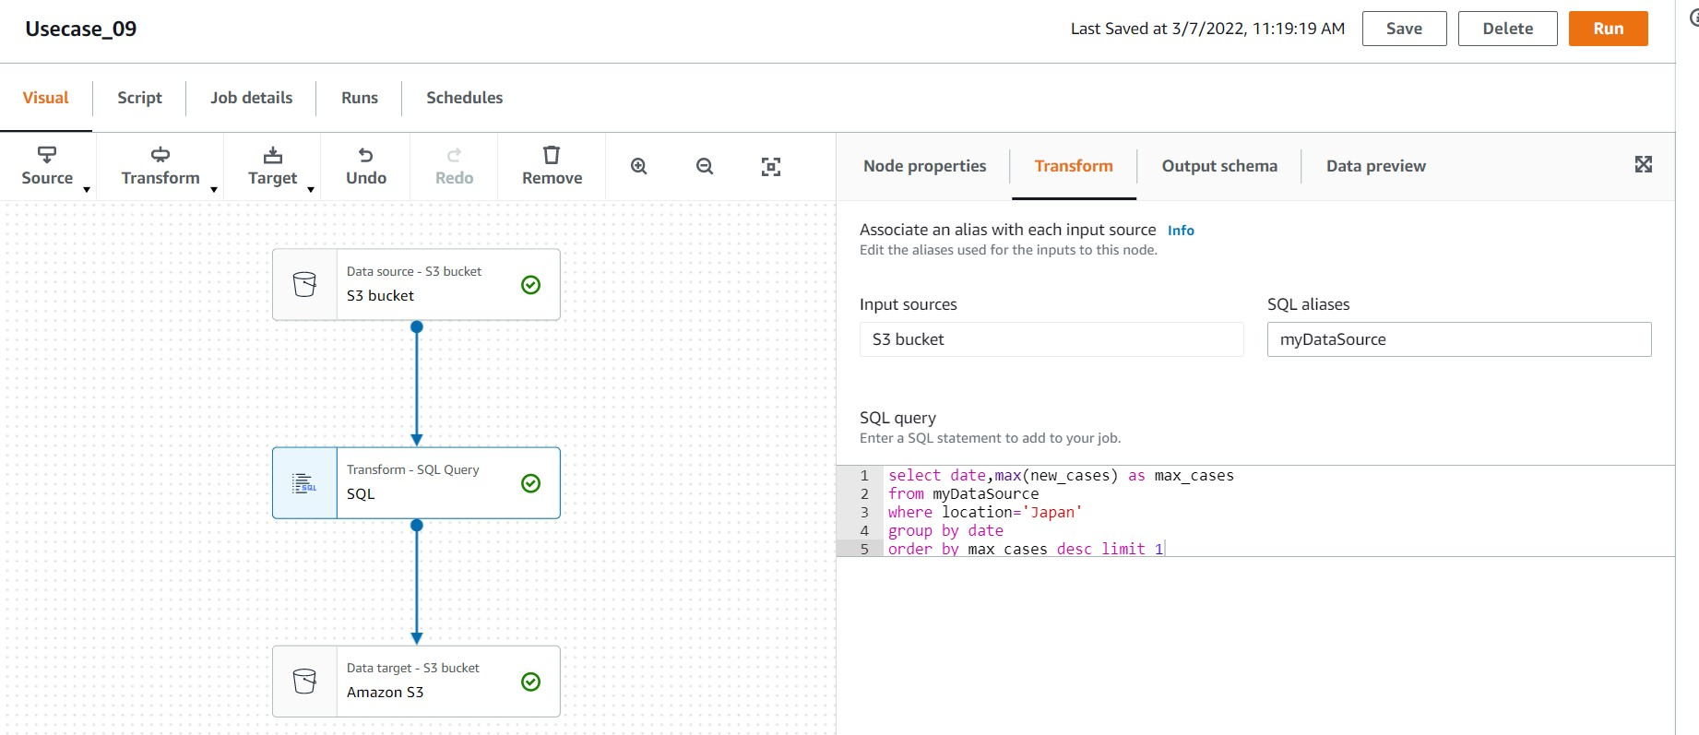

Slide 21
